Slide 1
Upper Tract TCC Management in 2025
Murtadha Almusafer
Prof. & Consultant of Urology
University of Basrah, College of Medicine, Basrah, Iraq
E.mail: murtadha.majeed@uobasrah.edu.iq

Slide 2
Disclosures
I do not have disclosures

Slide 3
Epidemiology
Urothelial carcinoma (UC) is the second most common urological malignancy in developed countries*
Upper tract urothelial carcinomas (UTUC) account for only 5-10% of Ucs**
*Siegel RL, Miller KD, Jemal A. Cancer statistics, 2019. CA Cancer J Clin. 2019;69:7–34.
**Gontero, P., et al., EAU Guidelines on Non-muscle-invasive Bladder Cancer (T1, T1 and CIS), in EAU Guidelines, Edn. presented at the 40th EAU Annual Congress Madrid, 2025.

Slide 4
The European Association of Urology Guidelines revealed that approximately 90% of bladder and renal pelvis cancer patients presented with transitional cell carcinoma*’**
*Witjes JA, Bruins HM, Cathomas R, et al. European Association of Urology Guidelines on muscle-invasive and metastatic bladder cancer: summary of the 2020 guidelines. Eur Urol. 2021;79:82–104.
**Roupret M, Babjuk M, Burger M, et al. European Association of Urology Guidelines on upper urinary tract urothelial carcinoma: 2020 update. Eur Urol. 2021;79:62–79

Slide 5
While the urinary tract carcinoma presented the same histology of TCC, differences such as tumor characteristics, epidemiology, treatment between TCC in different locations of the urinary tract and ignoring the significant differences may hinder us from optimizing therapy in patients with TCC*
*Singla N, Margulis V. Differences between upper tract urothelial carcinoma and bladder cancer. AUA news. 2021;26:15–6.

Slide 6
The peak incidence is in individuals aged 70–90 years and UTUC is twice as common in men
Shariat, S.F., et al. Gender differences in radical nephroureterectomy for upper tract urothelial carcinoma. World J Urol, 2011. 29: 481.

Slide 7
53.3% were former or current smokers.
The majority of patients (53%) were diagnosed after they presented with symptoms, mainly visible haematuria*
*Baard, J., et al. Contemporary patterns of presentation, diagnostics and management of upper tract urothelial cancer in 101 centres: the Clinical Research Office of the Endourological Society Global upper tract urothelial carcinoma registry. Curr Opin Urol, 2021. 31: 354. https://www.ncbi.nlm.nih.gov/pubmed/34009177

Slide 8
Approximately 9% of patients present with metastases*
*Aziz, A., et al. Stage Migration for Upper Tract Urothelial Cell Carcinoma. Clin Genitourin Cancer, 2021. 19: e184. https://www.ncbi.nlm.nih.gov/pubmed/33153919

Slide 9
Pyelocaliceal tumours are approximately twice as common as ureteral tumours and multifocal tumours are found in approximately 10–20% of cases*
*Green, D.A., et al. Urothelial carcinoma of the bladder and the upper tract: disparate twins. J Urol, 2013. 189: 1214. https://www.ncbi.nlm.nih.gov/pubmed/23023150

Slide 10
Concurrent BC is present in 17% of UTUC cases*
Whilst a prior history of BC is found in 41% of American men but in only 4% of Chinese men**
*Cosentino, M., et al. Upper urinary tract urothelial cell carcinoma: location as a predictive factor for concomitant bladder carcinoma. World J Urol, 2013. 31: 141. https://www.ncbi.nlm.nih.gov/pubmed/22552732
**Singla, N., et al. A Multi-Institutional Comparison of Clinicopathological Characteristics and Oncologic Outcomes of Upper Tract Urothelial Carcinoma in China and the United States. J Urol, 2017. 197: 1208. https://www.ncbi.nlm.nih.gov/pubmed/27887951

Slide 11
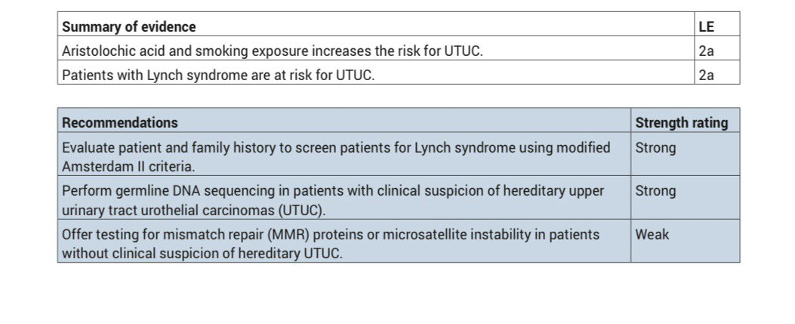
Summary of evidence and recommendations for epidemiology, aetiology, and histology

Slide 12
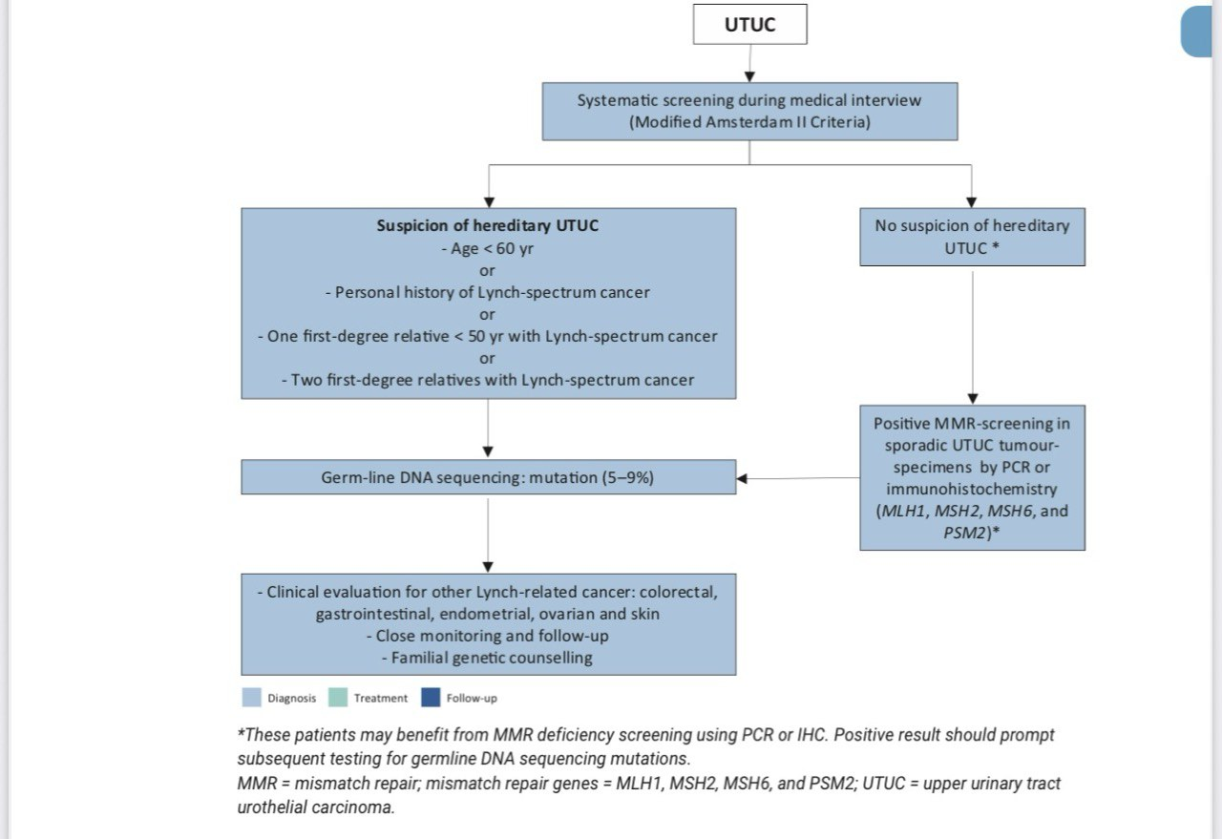
Selection of patients with UTUC for Lynch syndrome screening during the first medical interview

Slide 13
STAGING AND CLASSIFICATION SYSTEMS
The classification and morphology of UTUC and BC are similar*
However, because of the difficulty in adequate sample acquisition, it is often difficult to distinguish between non-invasive papillary tumours , flat lesions (carcinoma in situ [CIS]), and invasive carcinoma in biopsies.**
*Gontero, P., et al., EAU Guidelines on Non-muscle-invasive Bladder Cancer (T1, T1 and CIS), in EAU Guidelines, Edn. presented at the 40th EAU Annual Congress Madrid, 2025. https://uroweb.org/guidelines/non-muscle-invasive-bladder-cancer
**Subiela, J.D., et al. Diagnostic accuracy of ureteroscopic biopsy in predicting stage and grade at final pathology in upper tract urothelial carcinoma: Systematic review and meta-analysis. Eur J Surg Oncol, 2020. 46: 1989. https://www.ncbi.nlm.nih.gov/pubmed/32674841

Slide 14
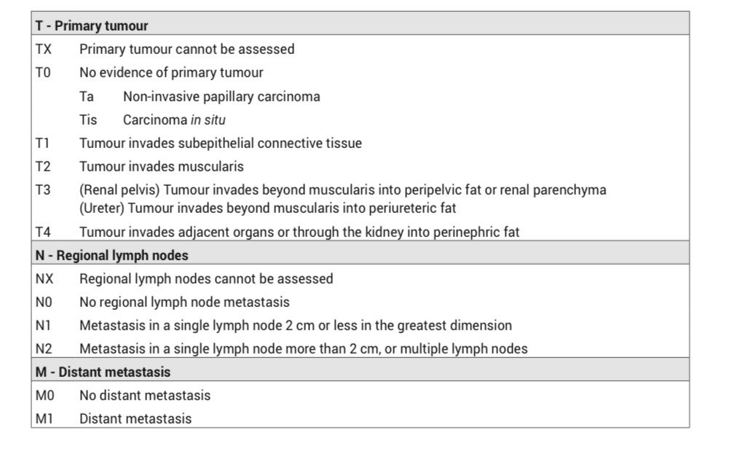
TNM classification 2017 for upper tract urothelial cell carcinoma

Slide 15
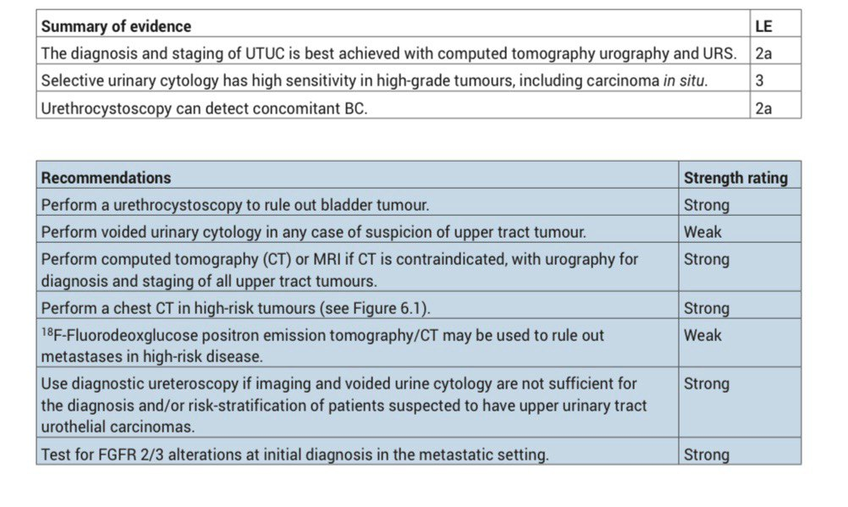
Summary of evidence and recommendations for the diagnosis of UTUC

Slide 16
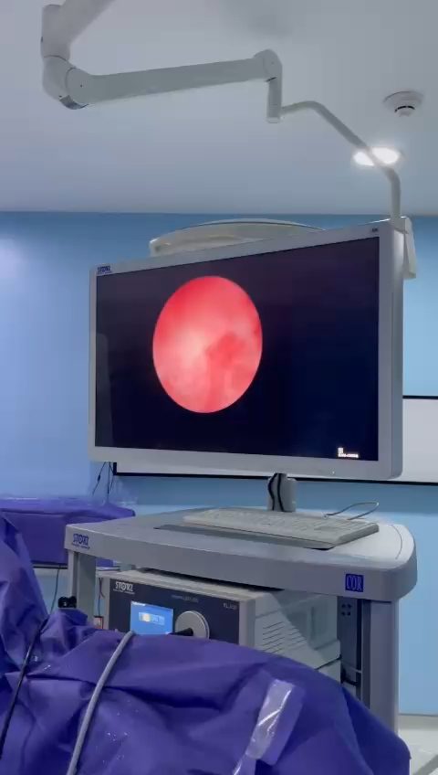
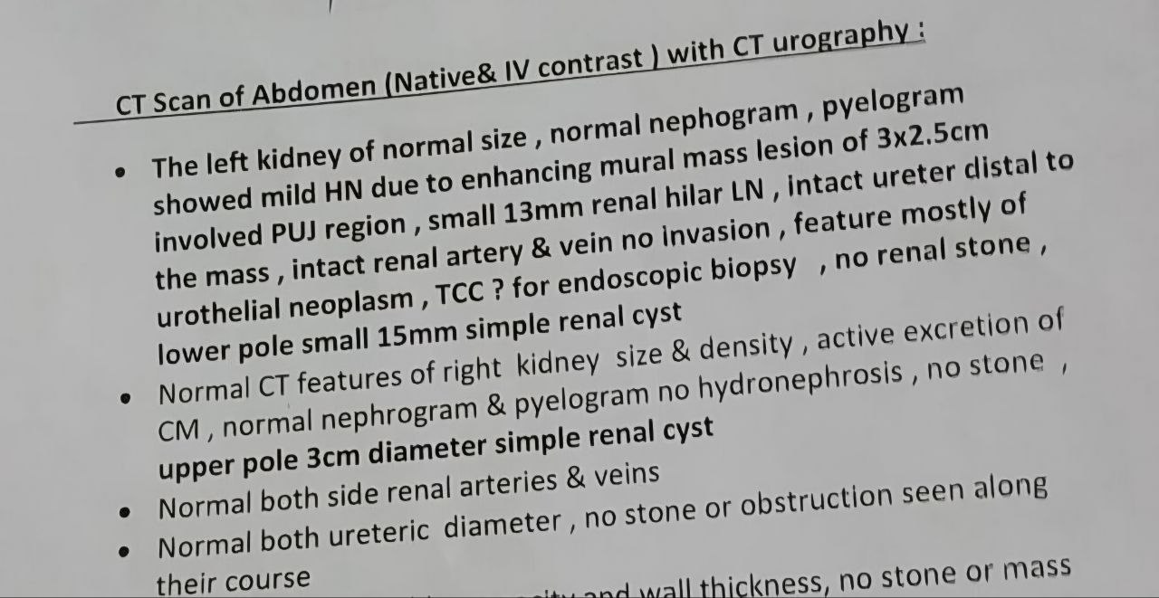
Diagnostic URS for CT Positive Renal Pelvic Mass

Slide 17
18F-Fluorodeoxglucose positron emission tomography/computed tomography
Reported promising sensitivity and specificity of 82% and 84%, respectively. Suspicious LNs on FDG
FDG-PET can also be used to assess (nodal and distant) metastases in patients unfit for iodinated contrast media due to renal impairment and/or allergy.*
*Voskuilen, C.S., et al. Diagnostic Value of (18)F-fluorodeoxyglucose Positron Emission Tomography with Computed Tomography for Lymph Node Staging in Patients with Upper Tract Urothelial Carcinoma. Eur Urol Oncol, 2020. 3: 73.

Slide 18
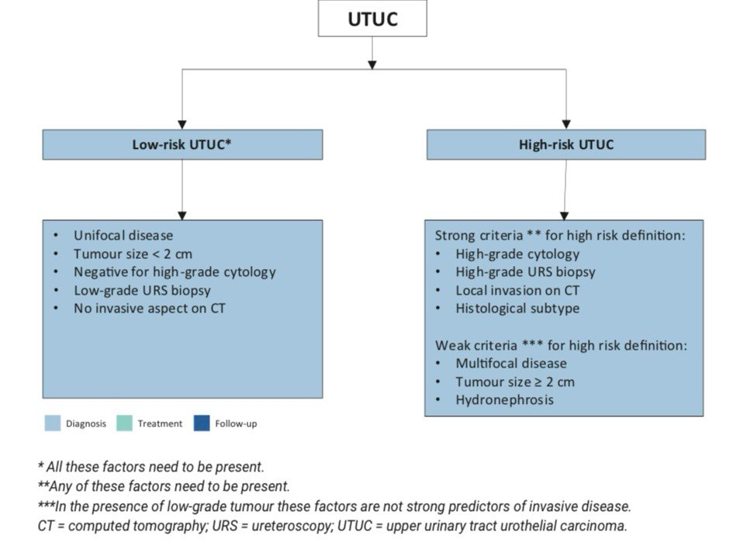
RISK STRATIFICATION
Risk stratification of non-metastatic UTUC according to the risk of progression to a > pT2/ non-organ-confined disease

Slide 19
Bladder recurrence
Three categories of predictors for increased risk of bladder recurrence were proposed:
1. Patient-specific factors such as male gender, previous BC, smoking and pre-operative chronic kidney disease.
2. Tumour-specific factors such as positive pre-operative urinary cytology, tumour grade, ureteral location, multifocality, tumour diameter, invasive pT stage, and necrosis.
3. Treatment-specific factors such as laparoscopic approach, extravesical bladder cuff removal, and positive surgical margins

Slide 20
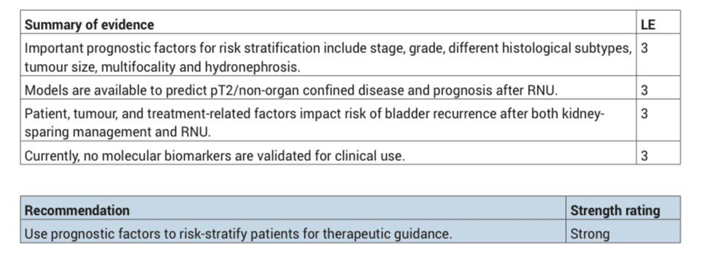
Summary of evidence and recommendation for the prognosis of UTUC

Slide 21
DISEASE MANAGEMENT
A multidisciplinary team prior to diagnostic ureteroscopy and the initiation of treatment*
*Parmar, K., et al. Focused UTUC pathways with a risk-stratified approach to diagnostic ureteroscopy: is it the need of the hour? A retrospective cohort analysis. World J Urol, 2024. 42: 76. https://www.ncbi.nlm.nih.gov/pubmed/38340192

Slide 22
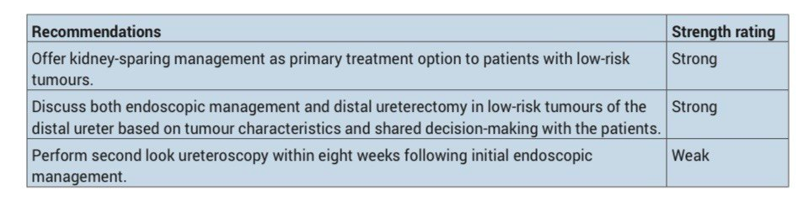
Recommendations for kidney-sparing management of localised low-risk UTUC

Slide 23
RNU
Regardless of the approach, RNU must be performed according to oncological principles to prevent tumour seeding:
1.Perform en bloc removal of the kidney, ureter and bladder cuff.
2.Avoid entering the urinary tract, except when performing a bladder cuff excision and only after prior clipping of the ureter and complete drainage of the bladder

Slide 24
Bladder cuff management
Resection of the distal ureter and its orifice is performed because there is a considerable risk of tumour recurrence in this area and in the bladder
Several techniques have been considered to simplify distal ureter resection, including the pluck technique, stripping, transurethral resection of the intramural ureter, and intussusception. None of these techniques have convincingly been shown to be equal to complete bladder cuff excision
Li, W.M., et al. Oncologic outcomes following three different approaches to the distal ureter and bladder cuff in nephroureterectomy for primary upper urinary tract urothelial carcinoma. Eur Urol, 2010. 57: 963

Slide 25
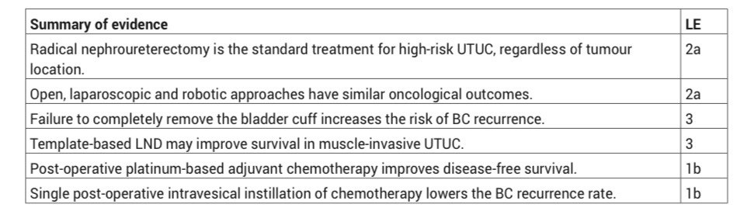
Summary of evidence and recommendations for the management of high-risk non-metastatic UTUC

Slide 26
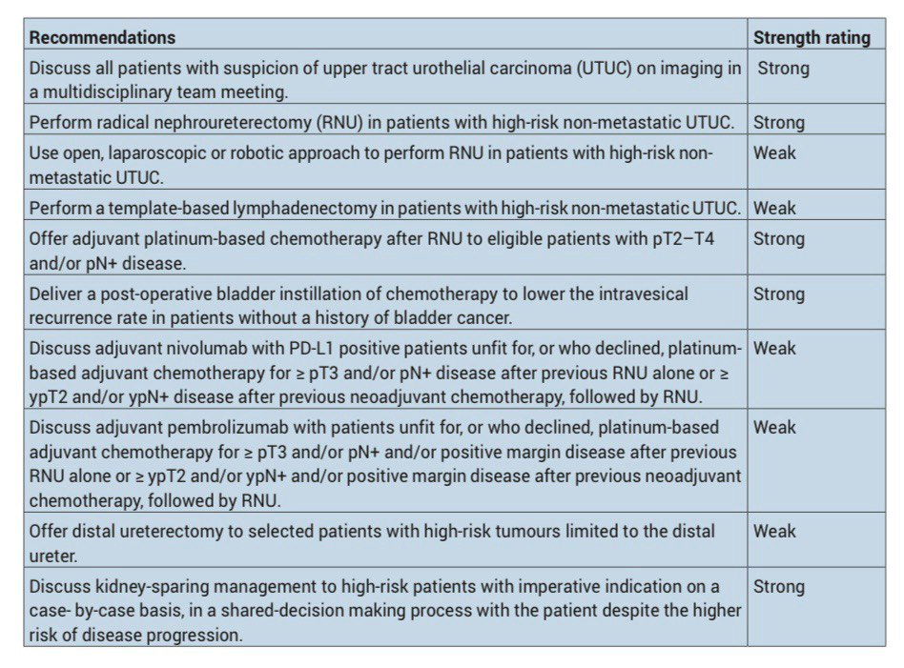

Slide 27
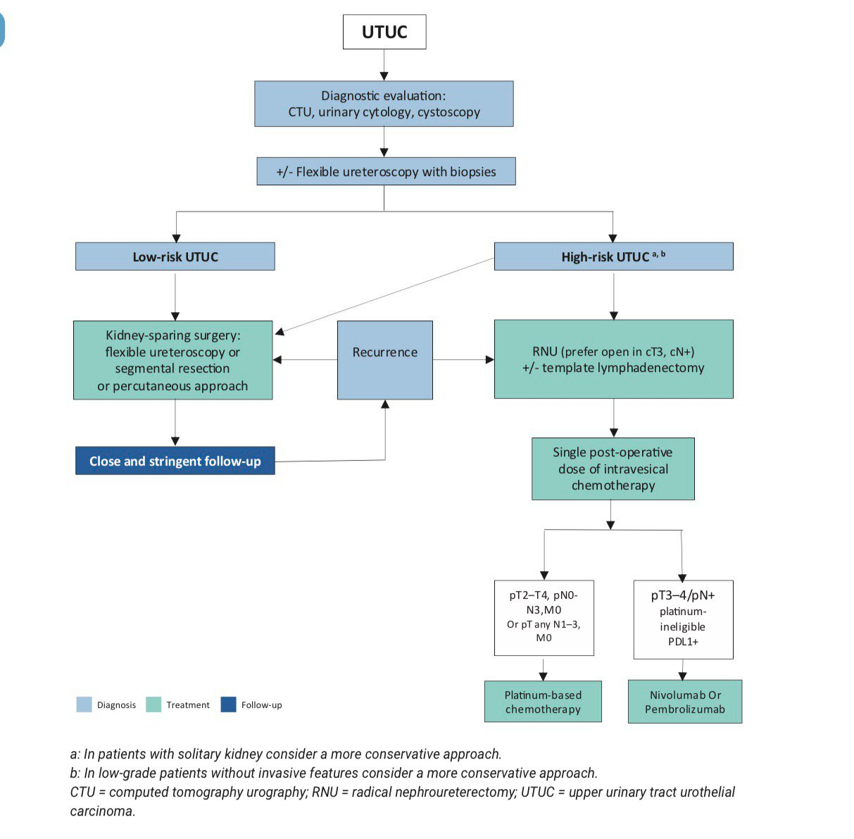
Proposed flowchart for the management of UTUC

Slide 28
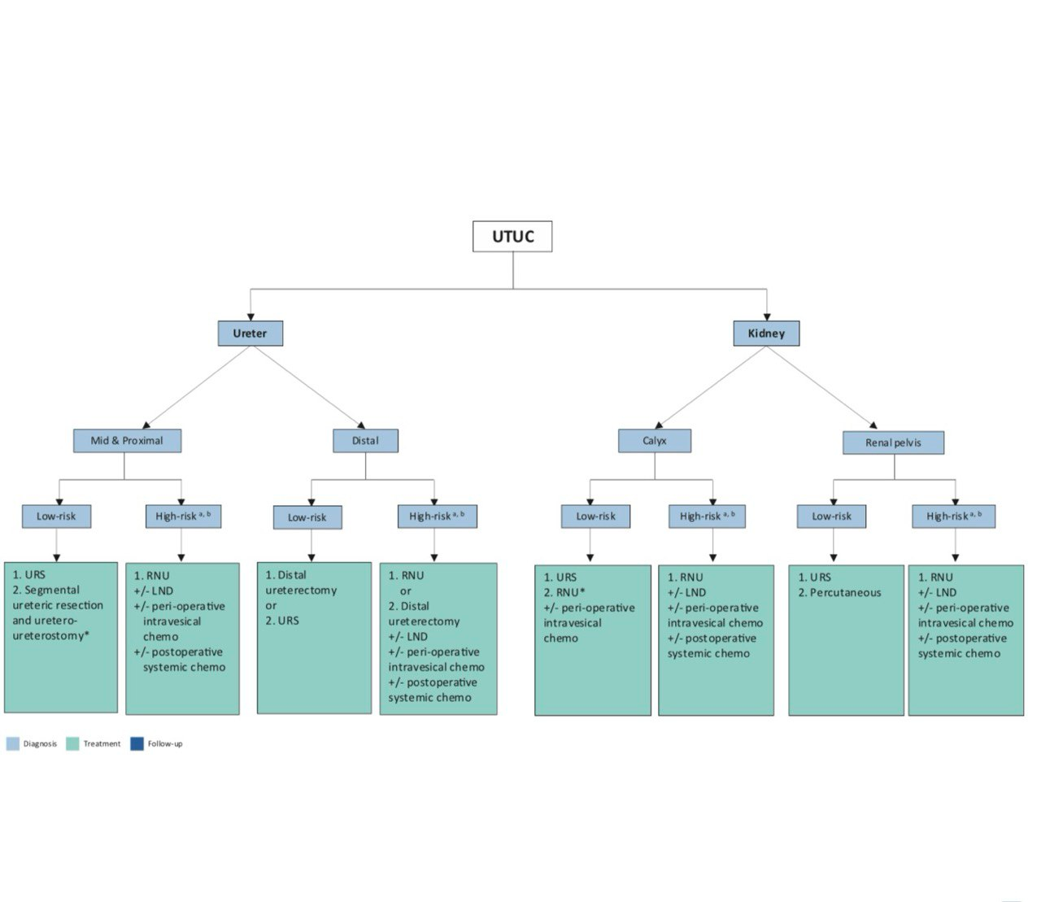
Surgical treatment according to location and risk status

Slide 29


